Slide 1
DOMKA LTD
THE CHALLENGES OF THE TIMES MEET THE SOLUTIONS OF DOMKAS.
THE NEW DESIGN OF THE CONCRETE PRODUCTION MACHINES IS NOW ESSENTIAL.
ΤΗΕ:
*ECOLOGICAL PROTECTION,
*ENERGY CONSUMPTION,
*LOW COST OF INFRASTRUCTURE AND INSTALLATION,
*SHORTAGE OF SKILLED LABOUR,
*ERGONOMIC LAYOUT,
*EMPLOYEE SAFETY,
*AUTONOMOUS OPERATION,
*AUTOMATED MAINTENANCE,
*VARIABLE PRODUCTIVITY ACCORDING TO DAILY REQUIREMENTS,
*CONCRETE QUALITY INCLUDING NEW CHALLENGES IN CHEMICAL ADMIXTURES AND REINFORCING MATERIALS,
ARE THE ELEMENTS OFFERED BY DOMKA IN A NEWLY DESIGNED CONCRETE PRODUCTION MACHINE.
THE MODELS:TIGER CONCRETE PRODUCTION MACHINE
IS AN IDEAL SOLUTION,BASED ON ALL THE ABOVE ELEMENTS AND DESIGNED TO EVOLVE ACCORDING
TO THE REQUIREMENTS OF NEW TECHNOLOGY.
THE WHOLE GOOD OPERATION PHILOSOPHY WAS BASED ON THE MANUFACTURING IN INDEPENDENT
DEPARTMENTS OF ALL THE DEPARTMENTS NECESSARY FOR THE PRODUCTION OF CONCRETE, GIVING
WEIGHT TO THEIR COMPLETE EQUIPMENT IN ALL DETAILS OF OPERATION AND MAINTENANCE.

Slide 2
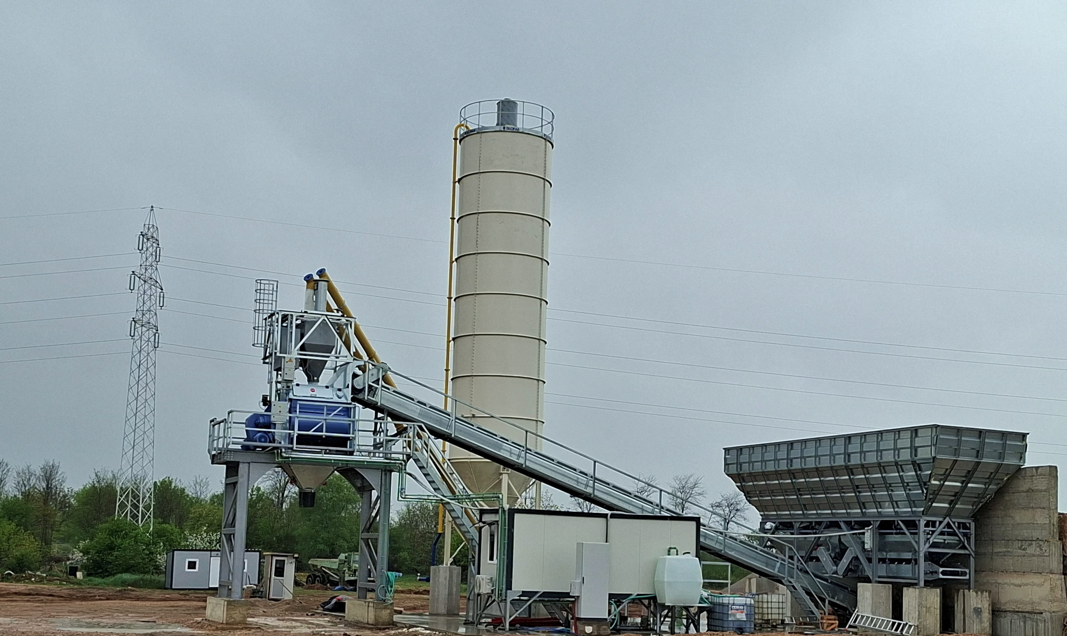

CONCRETE MACHINES MODEL,TIGER:
TYPE TIGER 80 IN CAPACITY:
*VIBRATION CONCRETE 80M3 PER HOUR,
*SOFT CONCRETE 95M3 PER HOUR
TYPE TIGER 100 IN CAPACITY:
*VIBRATION CONCRETE 100M3 PER HOUR,
*SOFT CONCRETE 115M3 PER HOUR.
STANDAR EQUIPMENT:
*(FOUR)4X30M3,AGGREGATES STORAGES,WITH 8 GATES(TWO FOR EVERY STORAGE).MICROWAVE SENSOR FOR THE SAND,
*(TWO)2X5TON,AGGREGATES SCALES,
*(TWO)BALANCES CONVEYORS FOR THE AGGREGATES SCALES,
*(ONE)CENTRAL CONVEYOR,
*(ONE)1 CEMENT SILO IN CAPACITY 200 TON,
*(TWO)2 CEMENT SCREW CONVEYORS(TWO SPEEDS),
*CONCRETE MIXER TWIN SHAFT,ON METALL BASE,
*CEMENT SCALE,WITH FILTER,
*WATER SCALE,WITH WATER PUMP(TWO SPEEDS),
*SCALE FOR TWO DIFFERENT TYPES OF CHEMICALS,
*WATER PUMP 9BAR-18M3/H,FOR FULLING THE TRUCKS AND WASHING,
*HIGH PRESSURE WATER PUMP(250 BAR),FOR FULL CLEANING THE CONCRETE MIXER AND THE TRUCKS,
*AIR COMPRESSOR,500L,
*CONTROL TOWER WITH AC/INVERTER AND TWO ROOMS.ONE FOR THE ELECTRICAL PANEL AND THE OPERATOR AND ONE FOR THE WATER-CHEMICAL AND AIR SYSTEM PARTS,
*ASSEBLY AND TRAIDING FOR CONCRETE PRODUCTION.
FOR MORE INFORMATIONS PLEASE CHECK OUT
THE RELATED VIDEO AND CONTACT US:

