Slide 1
DOMKA LTD
THE CHALLENGES OF THE TIMES MEET THE SOLUTIONS OF DOMKAS.
THE NEW DESIGN OF THE CONCRETE PRODUCTION MACHINES IS NOW ESSENTIAL.
ΤΗΕ:
*ECOLOGICAL PROTECTION,
*ENERGY CONSUMPTION,
*LOW COST OF INFRASTRUCTURE AND INSTALLATION,
*SHORTAGE OF SKILLED LABOUR,
*ERGONOMIC LAYOUT,
*EMPLOYEE SAFETY,
*AUTONOMOUS OPERATION,
*AUTOMATED MAINTENANCE,
*VARIABLE PRODUCTIVITY ACCORDING TO DAILY REQUIREMENTS,
*CONCRETE QUALITY INCLUDING NEW CHALLENGES IN CHEMICAL ADMIXTURES AND REINFORCING MATERIALS,
ARE THE ELEMENTS OFFERED BY DOMKA IN A NEWLY DESIGNED CONCRETE PRODUCTION MACHINE.
THE MODEL:DOUBLE TIGER CONCRETE PRODUCTION MACHINE
IS AN IDEAL SOLUTION,BASED ON ALL THE ABOVE ELEMENTS AND DESIGNED TO EVOLVE ACCORDING
TO THE REQUIREMENTS OF NEW TECHNOLOGY.
THE WHOLE GOOD OPERATION PHILOSOPHY WAS BASED ON THE MANUFACTURING IN INDEPENDENT
DEPARTMENTS OF ALL THE DEPARTMENTS NECESSARY FOR THE PRODUCTION OF CONCRETE, GIVING
WEIGHT TO THEIR COMPLETE EQUIPMENT IN ALL DETAILS OF OPERATION AND MAINTENANCE.

Slide 2
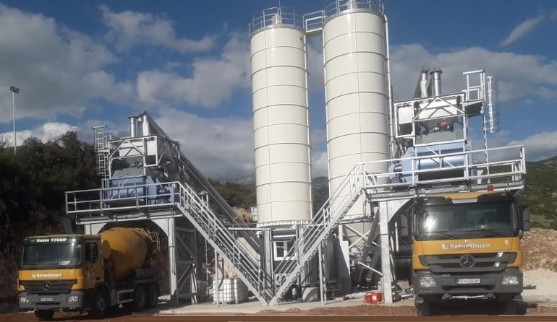

CONCRETE MACHINE MODEL,DOUBLE TIGER:
*CAPACITY:80-160 VIBRATION CONCRETE PER HOUR,
90-180 FRESH CONCRETE PER HOUR.
*PLACE FOR INSTALLATION 440 M2.(WITHOUT THE FULLING SYSTEM FOR THE AGGREGATES).
AGGREGATES STORAGES:
*CAPACITY 4X30=120M3,*GALVANIZED.
CONVEYOR:
*HICH SPEED,*COVERED,*GALVANIZED.
WATER AND CEMENT SCALES:
*TWO SPEEDS FULLING SYSTEM,*GALVANIZED,*CEMENT FILTER.
CEMENT SILOS:
*150-200 TONS,*CEMENT SCREW CONVEYORS WITH TWO SPEEDS,*SPECIAL AIR SYSTEM,*CEMENT FILTERS
CONTROL ROOM WITH:
*ELECTRICAL PANELS FOR THE MACHINE AND THE CEMENT SILOS,*COMPLETE WATER SYSTEM,FOR CONCRETE AND TRUCKS WASHING,*COMPLETE AIR SYSTEM, *COMPLETE CHEMICAL SYSTEM,*DESK FURNITURE WITH CHAIRS FOR TWO OPERATORS,*CIRCUIT WITH CAMERAS AND LOUDSPEAKER INSTALLATION,*AIRCONDITION WITH INVERTER.
FOR MORE INFORMATIONS PLEASE CHECK OUT THE RELATED VIDEO
AND CONTACT US:

